Slide 1
Demystifying Articulation Agreements with CTE programs for High School and Community Colleges
Presenters:
Bob Hawkes, Director Workforce Development, Kern CCCD, Bakersfield, CA
Marnie Melendez, CTE Specialist/Counselor – Oxnard College, Oxnard, CA
Sherry D. Davis, Ed.D., Education Programs Consultant, CTEAM (Perkins Unit), California Department of Education

Slide 2
Presenters Contact Information:
Bob Hawkes
  Director Workforce Development
  Kern County Community College District
  Email: bhawkes@kccd.edu
  Office: 661-336-5047
Marnie Melendez
  CTE Specialist/Counselor
  Oxnard College
  Email: mmelendez@vcccd.edu
  Office: (805) 986-5984
Sherry D. Davis, Ed.D.
  Education Programs Consultant, CTE Administration and Management Unit (Perkins)
  California Department of Education
  Email: sdavis@cde.ca.gov
  Office: 916-322-1767

Slide 3
Articulation… Why is it so difficult?
Problems with Articulation Agreements
Articulation Agreements that work
Requirements of Articulation for Perkins funding and the CA State Plan

Slide 4
Articulation Problems…
Some common issues or problems:
  Community colleges have cut the CTE program that would articulate
  CTE faculty/counselors at community colleges (or high schools) are not familiar with articulation agreements for their programs
  High schools (or community colleges) have not made an effort to build that relationship for articulation agreements
  Not sure how to design or write an articulation agreement (where to begin)…

Slide 5
Articulation Accomplished…
What is working well:
  Joint CTE meetings with counselors/teachers/instructors from high school/community college (at least twice a year)
  Joint CTE advisory meetings for high school and community college
  Business and Industry support of CTE programs at both levels of education in the community
  Review of older articulation agreements and new CTE programs for articulation agreements
    (The Perkins Act requires that those articulation agreements are to be reviewed annually by the state and local administrators)

Slide 6
Articulation Explained…
Requirements of Articulation:
  CTE programs from the secondary to the postsecondary with a non-duplicative sequence of progressive achievement leading to a skills proficiency, credential, certificate, degree, or professional license
  These courses can not be consider “remedial” in nature
  Statewide articulation agreements (should be in place)

Slide 7
Articulation Explained…
Requirements of Articulation:
  Dual and concurrent CTE enrollment programs (should be included)
  Academic and financial aid counseling should be included for CTE
  Any other initiatives to overcome barriers to participation in the opportunities
    Especially students that are considered rural and/or special populations

Slide 8
Demystifying Articulation Agreements…
Marnie Melendez
Articulation Agreements that have been working at Oxnard College
  One of three campuses with Ventura County Community College District on the Central Coast
  Working with the various High School Districts in Ventura, Santa Barbara, and western LA Counties

Slide 9
Articulation Benefits…
Successful Articulation Agreements Promotes:
  Student Retention
  Student Persistence
  Program Completion

Slide 10
Articulation Agreements
California CTE High School Programs
California CTE Community Colleges Programs
California CTE
4-Year University Programs

Slide 11


Articulation Agreement Partnership
Oxnard College
Oxnard Union High School District and ROP

Slide 12

Benefits
  Register to Oxnard College (early)
  Earn College Credit
  Minimize Course Duplication
  Identify Career Interest

Slide 13
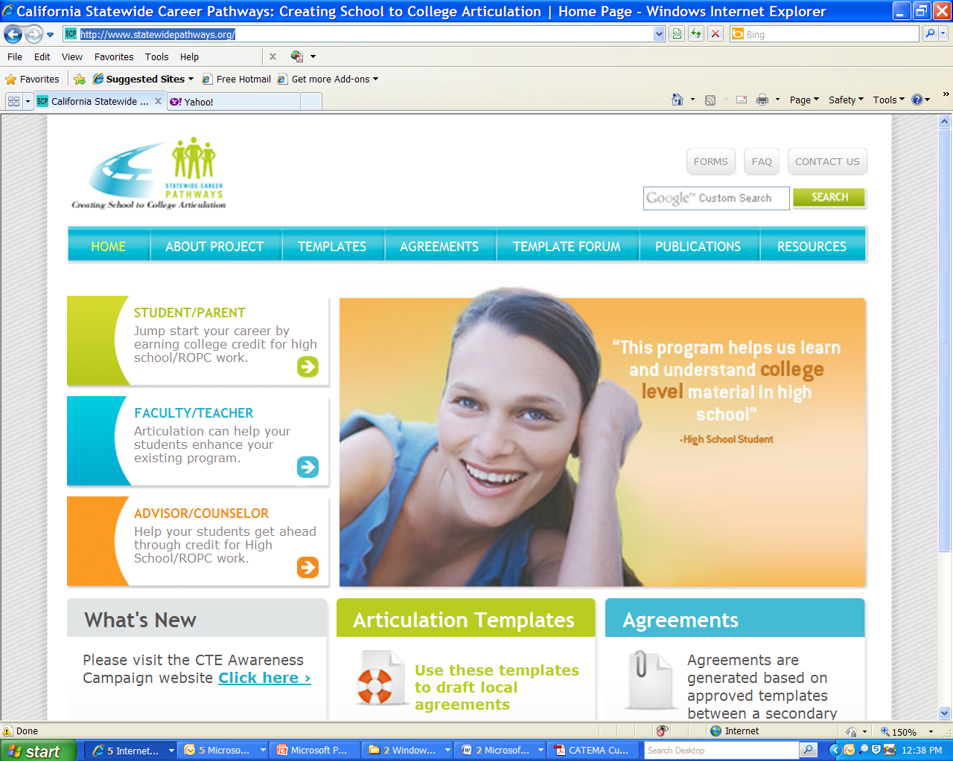
How to create High School Articulation Agreements

Slide 14
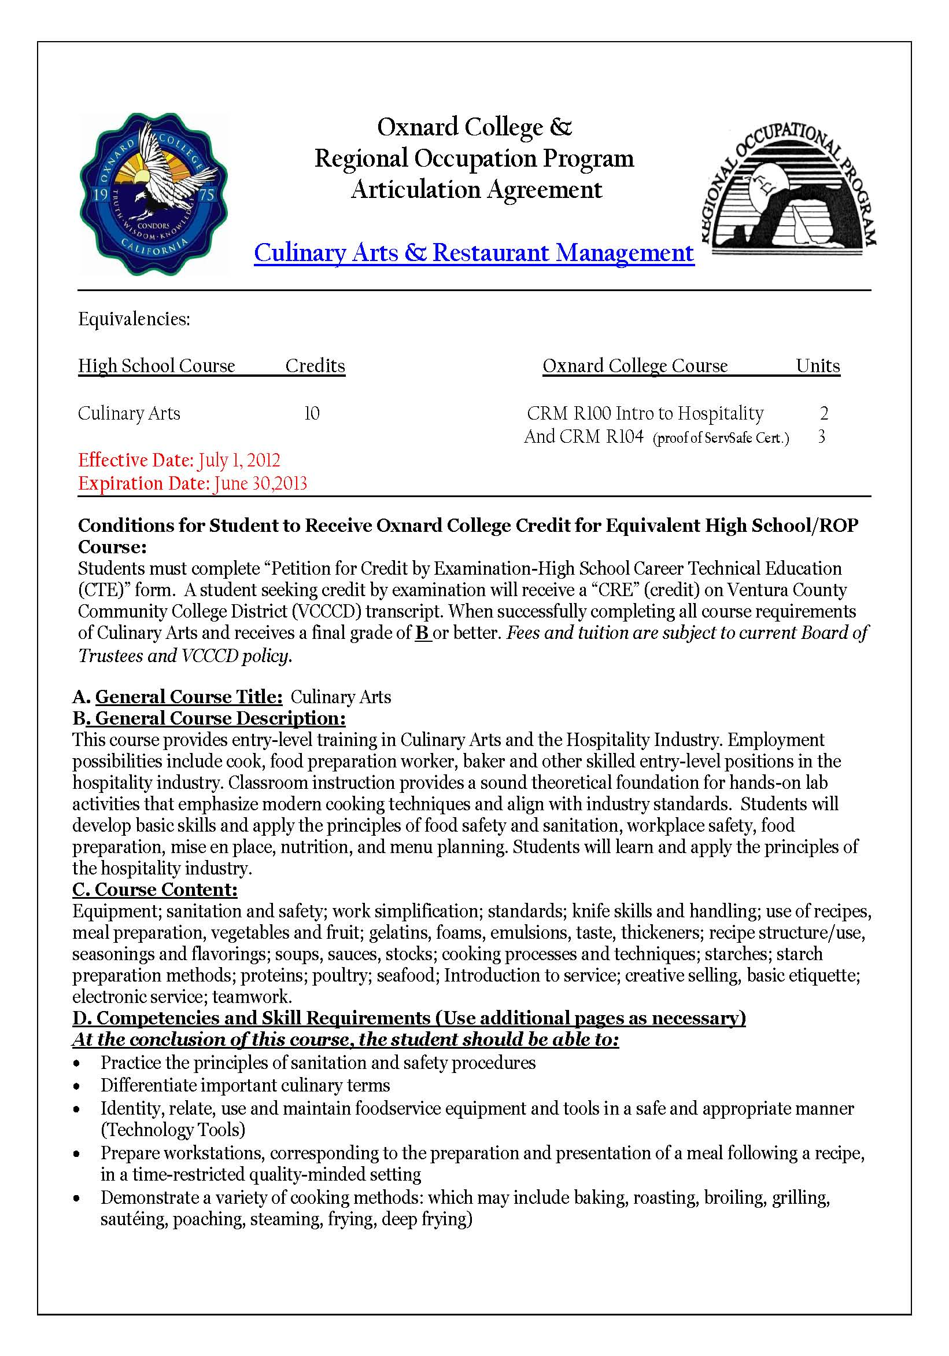
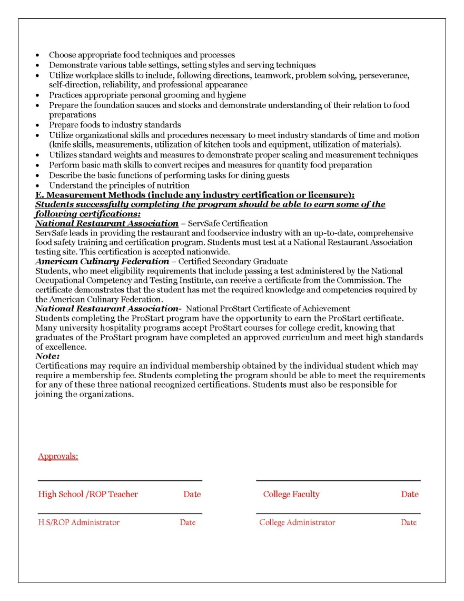

Slide 15
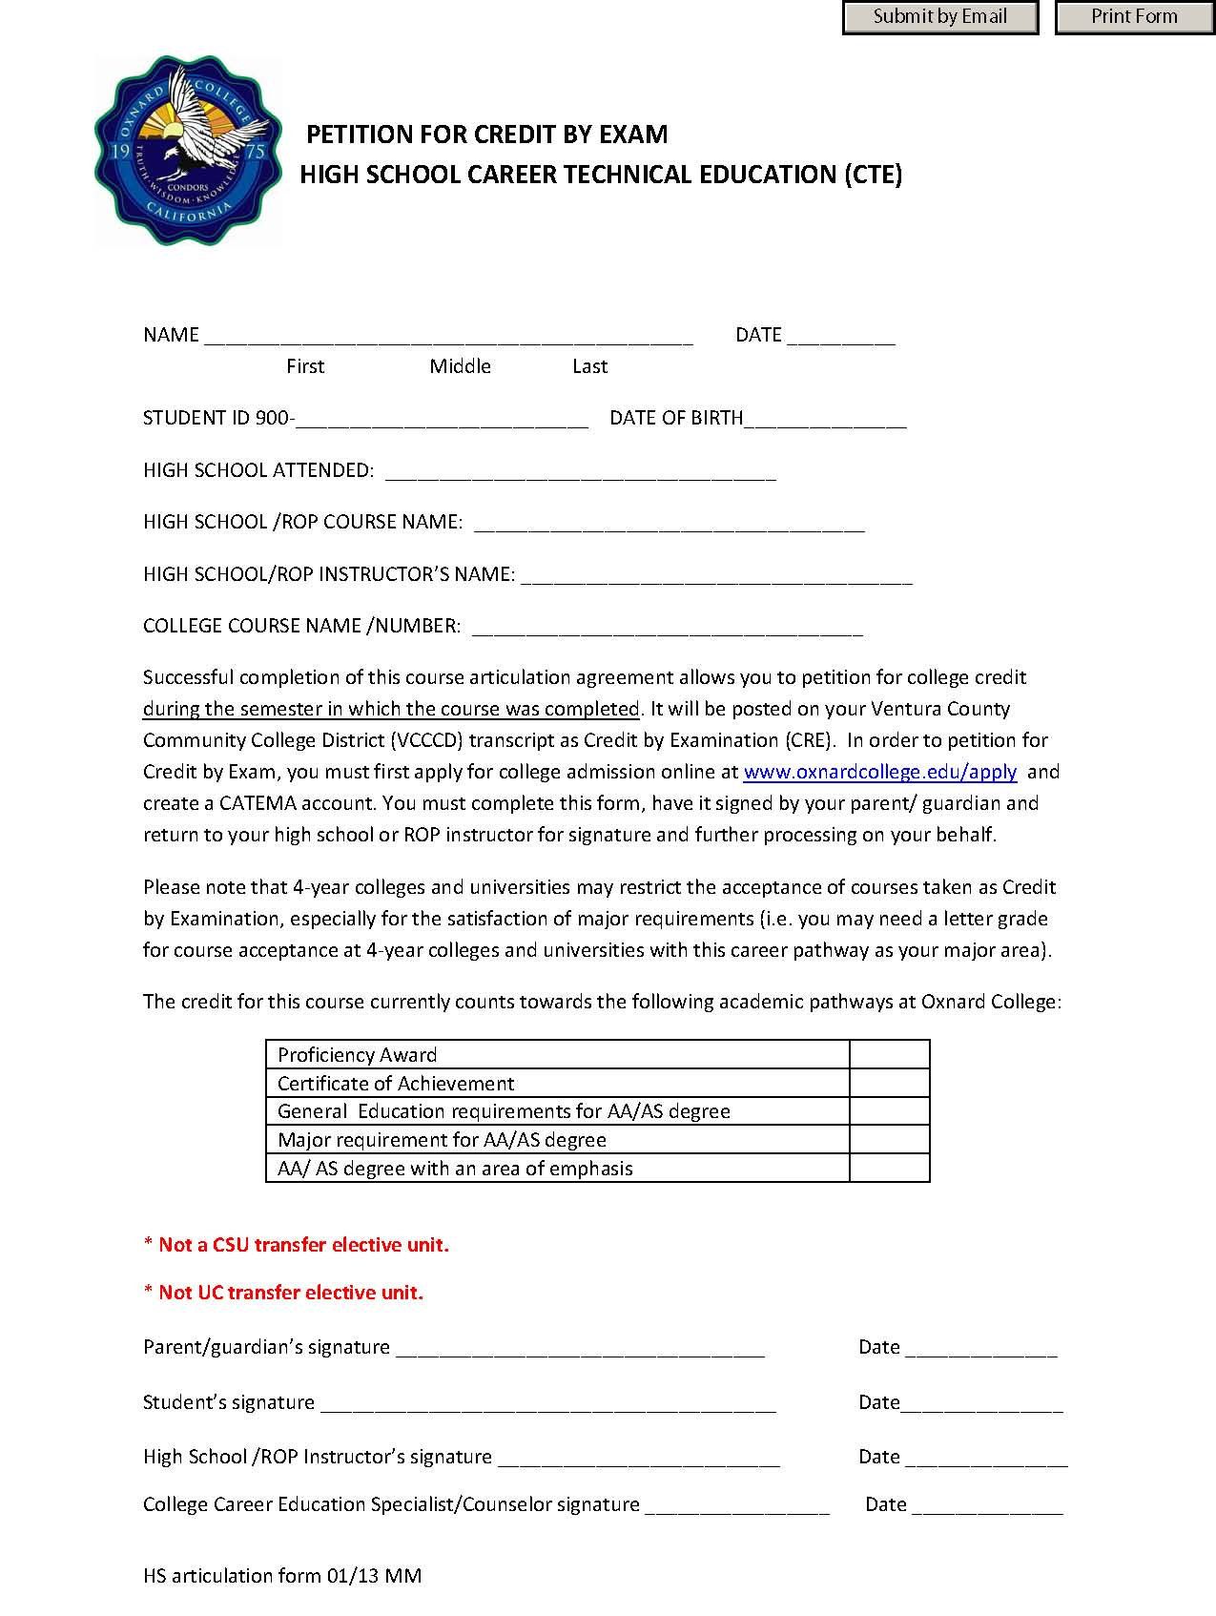

Slide 16
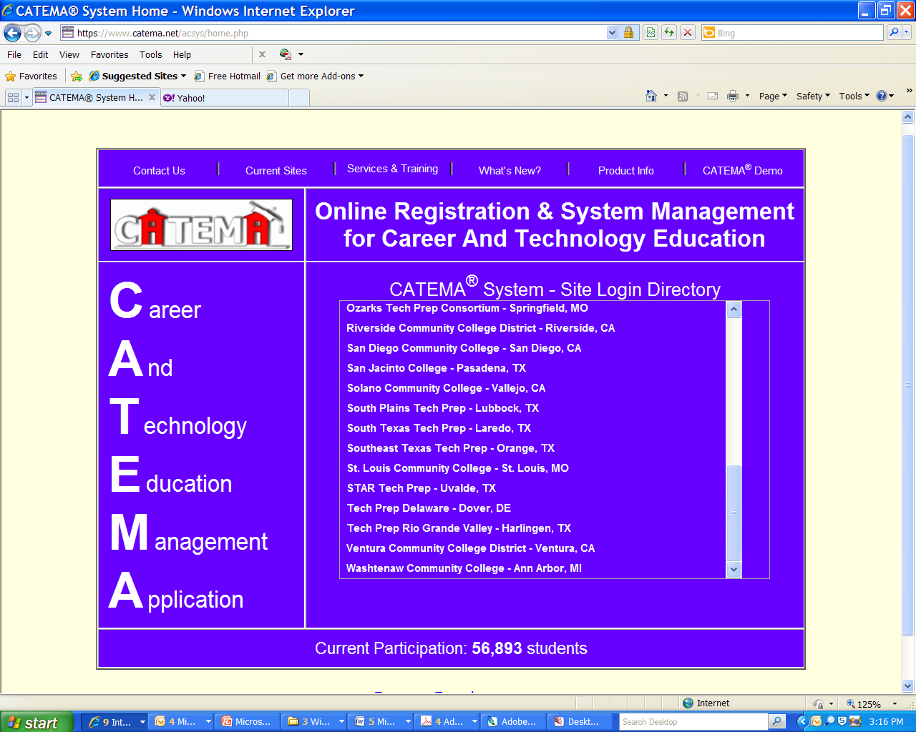
Tracking System we use
“CATEMA”

Slide 17

Benefits of
CATEMA
One place to manage and track high school articulation credit and students in program.

Slide 18

Process For Students
  Register to College
  Create CATEMA account
  Pass class with a “B” or better

Slide 19

High School CTE Teacher Process
  Create CATEMA account
  Accept Student
  Post grade

Slide 20

College/Postsecondary
CTE Faculty
Process
  Review and grant credit

Slide 21

College Registrar Process
Post college credit on students transcript.
DONE!

Slide 22
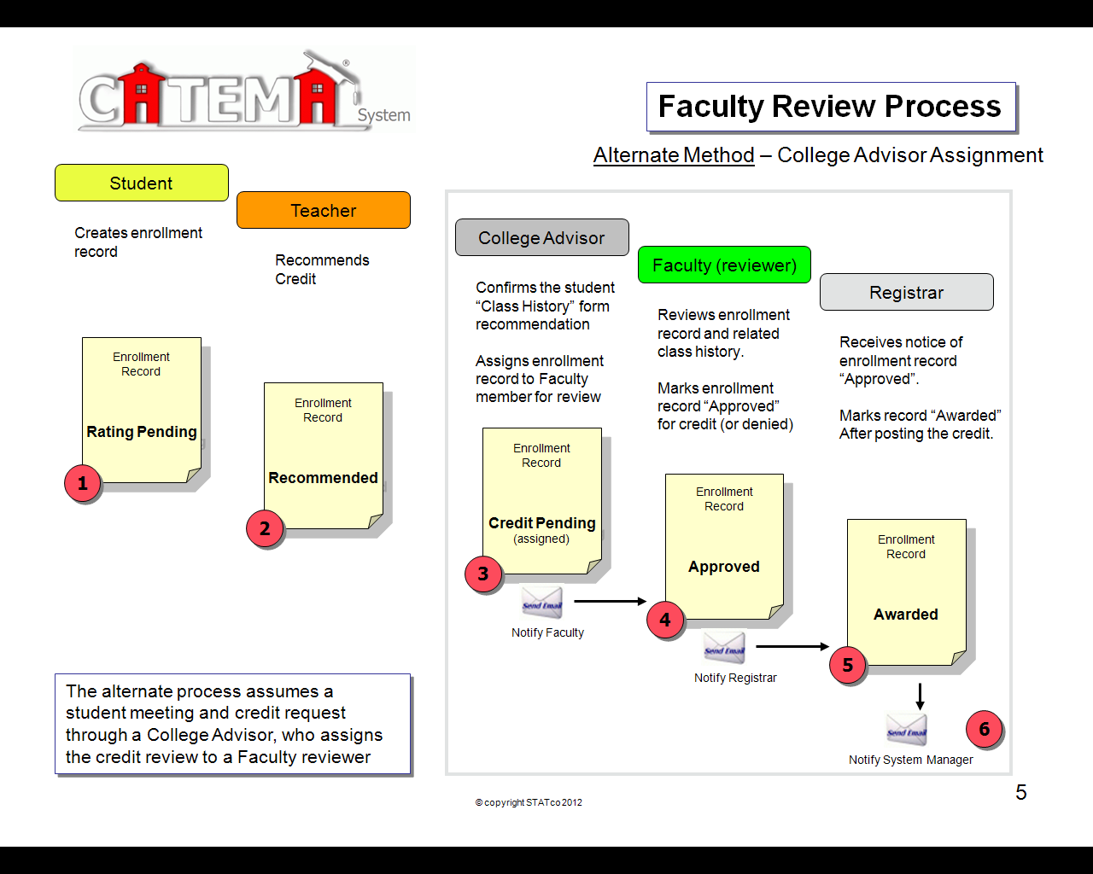

Slide 23
Questions???

Slide 24
Supplemental Information and Links
CDE Perkins web page:
  http://www.cde.ca.gov/ci/ct/pk/
CDE CTE Model Standards and Framework page:
  http://www.cde.ca.gov/ci/ct/sf/ctemcstandards.asp
CA Chancellor’s Office web page:
  http://www.cccco.edu/
CATEMA web page:
  https://www.catema.net/acsys/home.php
CA Statewide Career Pathways web page:
  http://www.statewidepathways.org/index.html
CTE Online web page:
  http://www.cteonline.org/

Slide 25
Thank you for attending this workshop
Please contact us further for more assistance or information

Slide 26
References:
ACTE. (2006). Perkins act of 2006: The Official Guide. ISBN: 100895140128. Alexandria, VA: ACTE publication
Brustein & Manasevit. (2010). EDGAR Plus. Education Department General Administrative Regulations. Tampa, FL: Thompson Publishing
CDE and CCCCO. (2008). 2008-2012 California State Plan for Career Technical Education: A Bridge to the Future. http://www.schoolsmovingup.net/cs/ctep/print/htdocs/ctep/home.htm
CDE Perkins. (2012). Perkins Resource web page. http://www.cde.ca.gov/ci/ct/pk/
Career and Technical Education Management Application. (2012). CATEMA: Online Articulation Program Management. https://www.catema.net/acsys/home.php
Carl D. Perkins Vocation and Technical Education Act of 2006 (PL 109-270). United States statues at large. Washington, DC: Government Printing Office. http://catalog.gpo.gov
Oxnard College. (2012). Articulation web page. http://www.oxnardcollege.edu/departments/student_services/articulation/index.shtml

